Slide 1
FACIAL RECOGNITION Gregg Legarda and Cristina Giraldo Machine Learning 1 DATS 6202

Slide 2
Our Plan and Execution
Proposal
Started to research about facial recognition
Face detection in images
Face detection in live feed
Haar Cascades
Increase Accuracy
HOG Algorithm
Instagram Web Scraping
Dash and Plotly User Interface
Capture and Retrain Features
Notes:
Proposal:
Must be able to identify between Gregg and Cristina

Slide 3
Researching
Packages
Algorithms
Face Detection
Notes:
We found out about packages such as OpenCV, face_recognition
Algorithms such as Haar Cascades, HOG, CNN
We started researching about face recognition in images

Slide 4
Face Detection in Images
Notes:
Show example
After our success in this,
We moved on to do implementing this code to a live webcam feed

Slide 5
Haar Cascades
First live face detection
Moved on to Recognition
More Problems with accuracy
Gradients
Notes:
At first, there were many problems but when we got through them, We made our first face detection live.
We decided to move on to recognition
When we tried implementing Haar Cascades in out code, it worked great
But it was confused on recognition. It made a lot of mistakes because of bias in color and brightness.
So… we added gradients to the code.
(show the next slide)

Slide 6
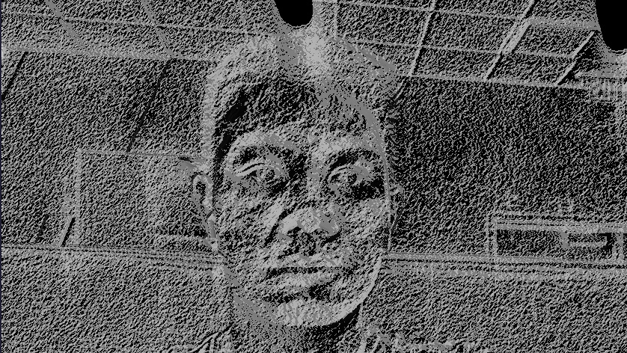
Gradients on Web Cam Feed
Notes:
Was able to finally identify between Gregg and Cristina
But there were more problem that we didn’t like
Problems:
When adding more faces, it became less and less accurate
We needed a huge collection of data to train another cascade
Will take 4 hours to train each cascade, will need hundreds of different images.

Slide 7
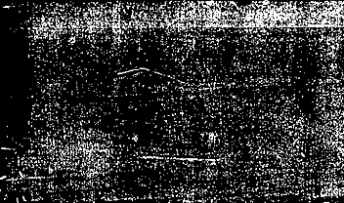
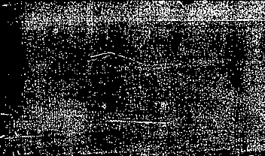
Haar vs. HOG

Slide 8
Haar Cascades
Advantages
Faster
Great at face detection
Initially less accurate than HOG
Disadvantages
Bad at recognition
Needs a bigger data set
Time consuming
Notes:
Advantages
Faster
Great at face detection (But sometimes detects faces where there are no faces) Because Haar algorithm is based on line detection.
Less accurate than HOG but can be better depending on data sets. Can be accurate if trained properly (create and train own cascade)
Disadvantages
Bad at recognition (mistakes some faces for other faces)
Needs a bigger data set to train for specific people. 100 images to train a cascade
Time consuming if accuracy is critical

Slide 10
HOG Algorithm
Advantages
Very accurate face detection
No need to train its own cascades s
Great at face recognition
Disadvantages
Slower than Haar
Notes:
Advantages
Very accurate face detection (doesn’t over compensate like the haar)
No need to train its own cascades since it uses gradient to recognize patterns
Great at face recognition (although still not perfect)
Disadvantages
Slower than haar but still fast enough to detect faces

Slide 12
Extra Features
Web Scraping
Dash Plotly User Interface
Capture Image and Retraining Option
Notes:
We decided to add additional features to our code
We used webscraping to link our Instagram accounts to the live face recognition
We throught a User interface would look cool for the presentation
We decided to ad a retrain and caputure option

Slide 13
Demo
(It is not perfect with recognition but is pretty accurate)

Slide 14

Code
Imports and packages needed
Notes:
IMPORTS AND PACKAGES NEEDED
cv2
face_recognition
Imutils

Slide 15
Notes:
Applications and other things that we can use our code for.
Link to github

